Slide 1
Clinical forecasting for or duration
January 8, 2019

Slide 2
Development Team
Executive Sponsor – x, VP Surgical Services
Business Owner – x
Data Science Lead – Matthew Brown
Data Science Team
x, Data Scientist
x, Consulting Data Analyst
x, Analytics Manager
Collaborators
x, Performance Improvement - Analytics
x, Manager Clinical Data
Notes:
Innovation Portal – select 3 elements for questions. This is first gate before pursuing further.

Slide 3
Agenda
Business Insights & Operational Levers
Model Features
The Model In Action
Discussion on Piloting & Communication
Next Steps
Notes:
Innovation Portal – select 3 elements for questions. This is first gate before pursuing further.

Slide 4
Business Insights & Operational Levers

Slide 5
Business Opportunity
xx%
Scheduled Duration Accuracy (2017)
Operations
↓ Variation = ↓ Delay x ↑ Utilization
Resource Coordination
Patient Experience
Delay > 60 min → Decreased Ratings
Service Level Targets
xx%
Under-Scheduled
by 20%+
xx%
Over-Scheduled
by 20%+
Financial Framework
Contribution Margin ↔ Utilization
Variable Costs ↔ Delay
Performance Target: 5 - 10% improvement in Schedule Duration Accuracy
Notes:
Innovation Portal – select 3 elements for questions. This is first gate before pursuing further.

Slide 6
Operations Theory
↓Variation = ↓Delay x ↑Utilization
Delay
Quality Target
Utilization
100%
Notes:
Innovation Portal – select 3 elements for questions. This is first gate before pursuing further.

Slide 7
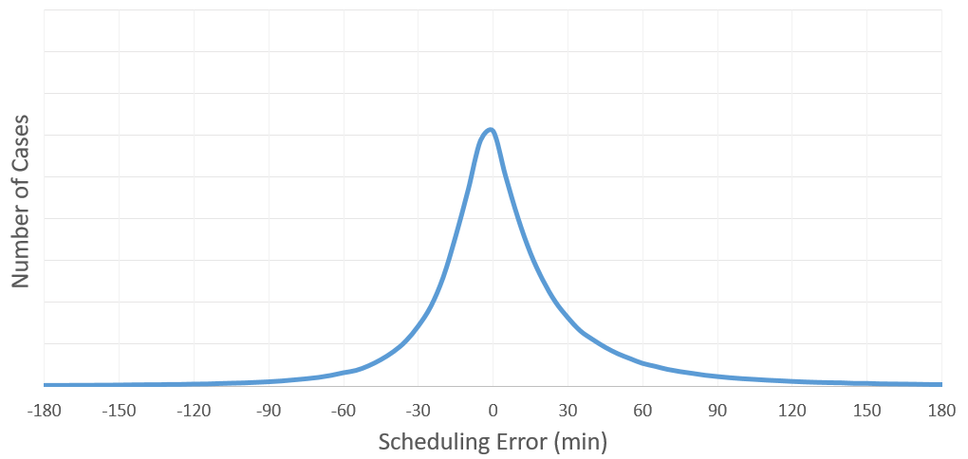
Operations
Root cause contributing to under-utilization
Root cause contributing to delays
OVER Scheduled Cases
UNDER Scheduled Cases
Notes:
Innovation Portal – select 3 elements for questions. This is first gate before pursuing further.

Slide 8
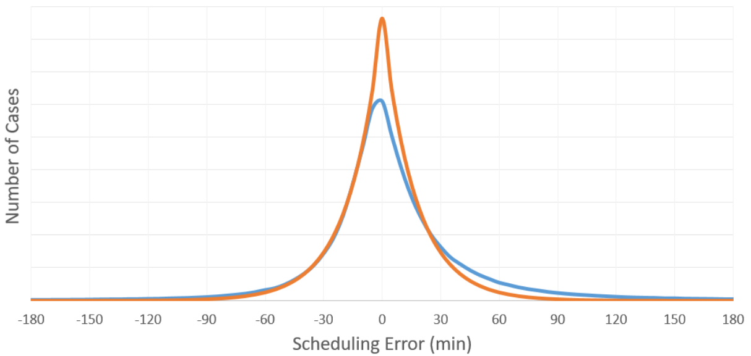
Operations
GOAL: Reduce error & variation
GOAL
GOAL
Notes:
Innovation Portal – select 3 elements for questions. This is first gate before pursuing further.

Slide 9
Patient Experience - Duration
Facility Rating
Recommends Facility
Chart Removed
Chart Removed
There is no direct correlation between patient satisfaction and duration.
Notes:
Innovation Portal – select 3 elements for questions. This is first gate before pursuing further.

Slide 10
Patient Experience – Delay
Facility Rating
Recommends Facility
Chart Removed
Chart Removed
Patients satisfaction significantly decreases with delay,
a symptom of under-scheduling.
Notes:
Innovation Portal – select 3 elements for questions. This is first gate before pursuing further.

Slide 11
Financial Framework
$xxB
HCA Revenue (Projected ‘18)
xx%+
Revenue from Surgery
Operating Income from Surgery
Contribution Margin
Variable Cost
Improve Utilization
Reduce Delay
Moving the needle even 1% could have a significant impact on income.
The operational focus should be informed by the proportion of CM to VC.
Notes:
Innovation Portal – select 3 elements for questions. This is first gate before pursuing further.

Slide 12
Data Science Model

Slide 13

Model Description
Data
Model
Predictions
2.5 Million Cases
Patient Details
Surgery Details
Surgeon Details
Facility Details
Scheduled Duration
Historical Durations
Gradient Boosting
Machine
Doe, Jane
M00123456789
Thrombectomy
Dr. Jackson
Scheduled: 75 min
CLIFFORD: 200 min
Actual: 220 min
Notes:
Innovation Portal – select 3 elements for questions. This is first gate before pursuing further.

Slide 14
Features
Facility
Patient
Surgery
Appointment
Details Removed
Surgeon
Notes:
Innovation Portal – select 3 elements for questions. This is first gate before pursuing further.

Slide 15
Model Parameters
Feature Importance
Chart Removed
Notes:
Innovation Portal – select 3 elements for questions. This is first gate before pursuing further.

Slide 16
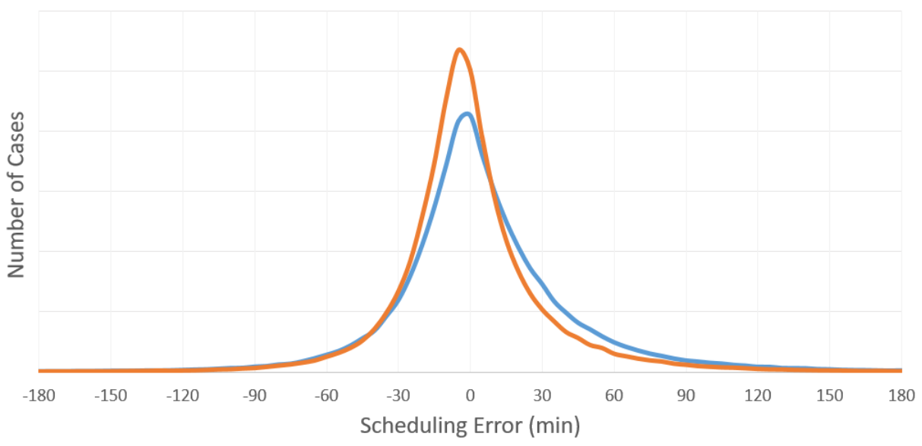
Model Performance (VALIDATION SET)
Schedule σ = 30.7 min
Model σ = 24.6 min
20% Improvement
in error & variation
Notes:
Innovation Portal – select 3 elements for questions. This is first gate before pursuing further.

Slide 17
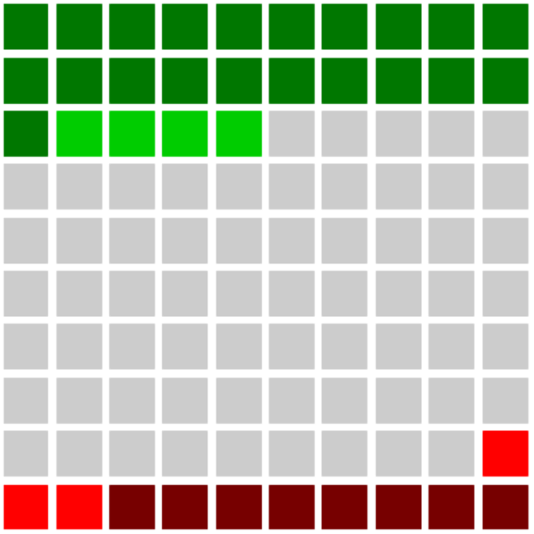
Model Performance (VALIDATION SET)
25%
Model Better than Schedule
36%
The model disagreed with the schedule.
64%
Model Agreed ± 15min
69%
The model was more accurate in the
disagreement.
11%
Model Worse than Schedule
Notes:
Innovation Portal – select 3 elements for questions. This is first gate before pursuing further.

Slide 18
Example Case #1
Case
Outcome
Details Removed
Analysis
Data used by CLIFFORD to make a better prediction
Notes:
Innovation Portal – select 3 elements for questions. This is first gate before pursuing further.

Slide 19
Pilot Planning

Slide 20
Project Overview
Our goal is to build and deploy a data science product that will enable improved scheduling of elective and planned surgeries at our hospitals, starting with case duration.
Initiation
Ideation
Exploration & Modeling
POC
Build
POC
Field Test
Innovation
Review
Lifecycle Phase: PoC Build
Top Priority: Operationalizing the current model. Identifying PoC partner.
Notes:
Innovation Portal – select 3 elements for questions. This is first gate before pursuing further.

Slide 21
Product Lifecycle & Development
Initiation
Ideation
Exploration & Modeling
POC
Build
POC
Field Test
Innovation
Review
Activities
Decisions / Information
Artifacts
● PoC kickoff meeting
● Site visit and end-user meeting
● Model signal review & approval
● QA testing on data pipelines
● Architecture design
● Operations planning
● Solution/Application development
● Develop PoC implementation plan
● Early stage enterprise planning
● Decide PoC end-goals / KPIs
● Decide PoC platform architecture
● Decide PoC delivery mechanism
● Identify end-users to engage
● Identify project champions to engage
● PoC Charter (Strategy, Timeline, Responsibilities, Commitment, etc…)
● PoC Implementation & Operations Plan
● PoC Tech Requirements & Documentation
● PoC Service Level Agreement
● Model & Data Pipeline Signoff
● Product Owner Go/No-Go Signoff
Target PoC MVP Complete: March 1, 2019
● Complete ● In Progress ● Not Started ● Stalled
Notes:
Innovation Portal – select 3 elements for questions. This is first gate before pursuing further.

Slide 22
TIMELINE
Aug | Sept | Oct | Nov | Dec | Jan ‘19 | Feb | Mar
Ideation
Explore & Model
PoC Build
Quarterly
SteerCo
Model
Review
Quarterly
SteerCo
* For illustrative purpose

Slide 23
Next Steps
Approve model for Proof Of Concept - COMPLETE
Select a pilot location to partner with in developing the PoC – Incomplete
Begin operationalizing the current model – Actively In Progress
Engage pilot site / potential users – Not Started
Develop delivery mechanism – Not Started
Develop pilot plan – Not Started
Continue to iterate on the model as we learn more – On Going
How should we communicate this initiative to others including pilot sites?
Notes:
Innovation Portal – select 3 elements for questions. This is first gate before pursuing further.

